Slide 1
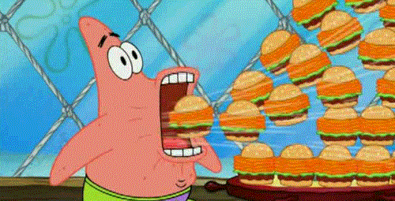
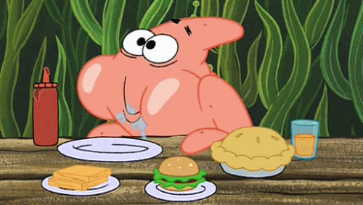
I’m starving!!!
I want ……

Slide 2
fly
I want a hot dog.

Slide 3
jump
I want an egg.

Slide 4
swim
I want a cupcake.

Slide 5
sing
I want some bread.

Slide 6
sing
I want some juice.

Slide 7
swim
I want some milk.

Slide 8
swim
I want some tea.

Slide 9
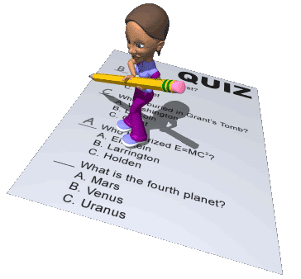

Slide 10
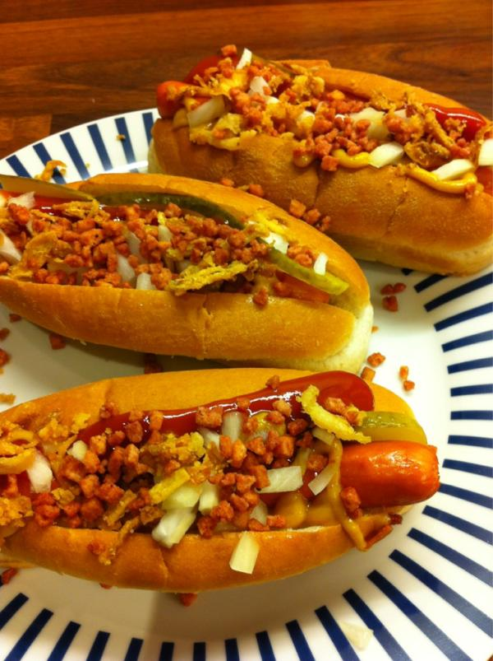
What do you want?
(A) a hot dog (B) hot dogs (C) cupcakes

Slide 11
What do you want?
a tea
some tea
teas

Slide 12
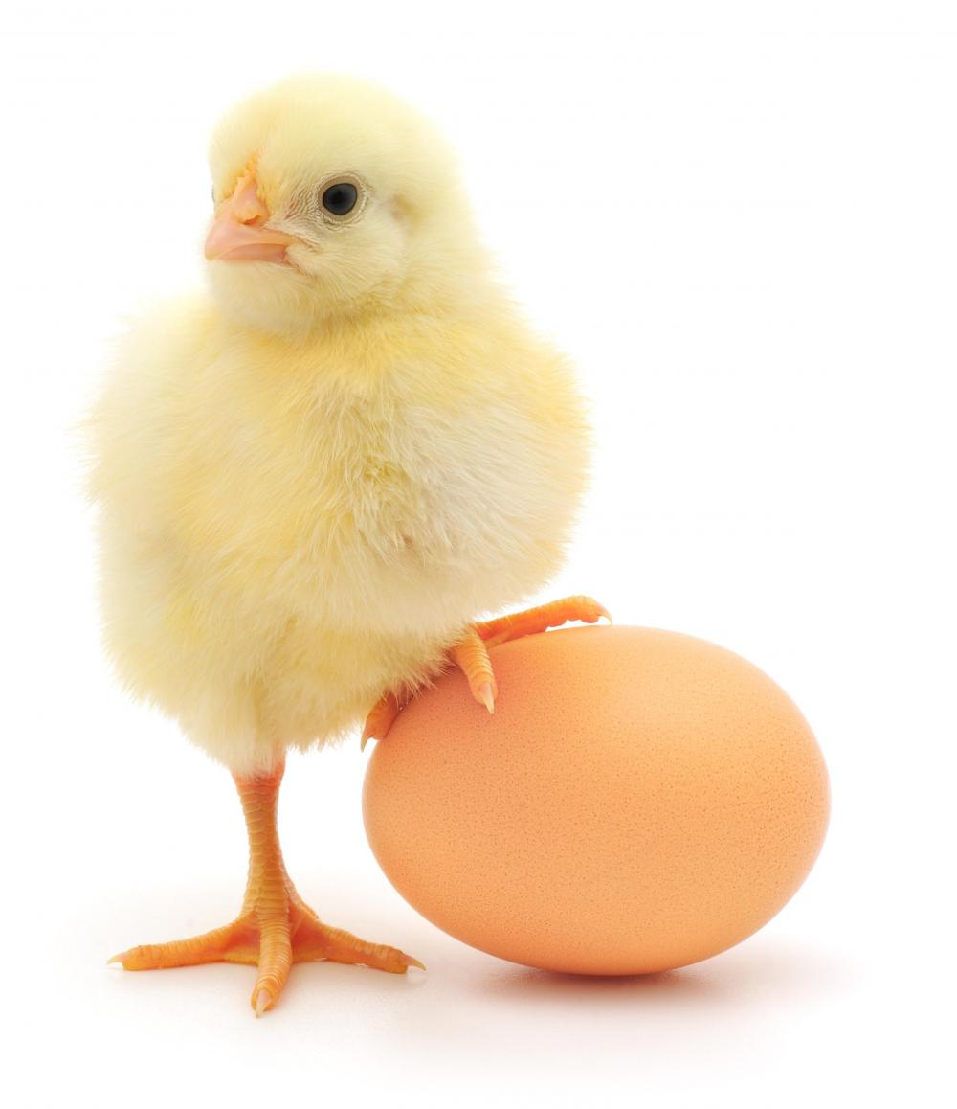
What do you want?
a egg
some eggs
an egg

Slide 13
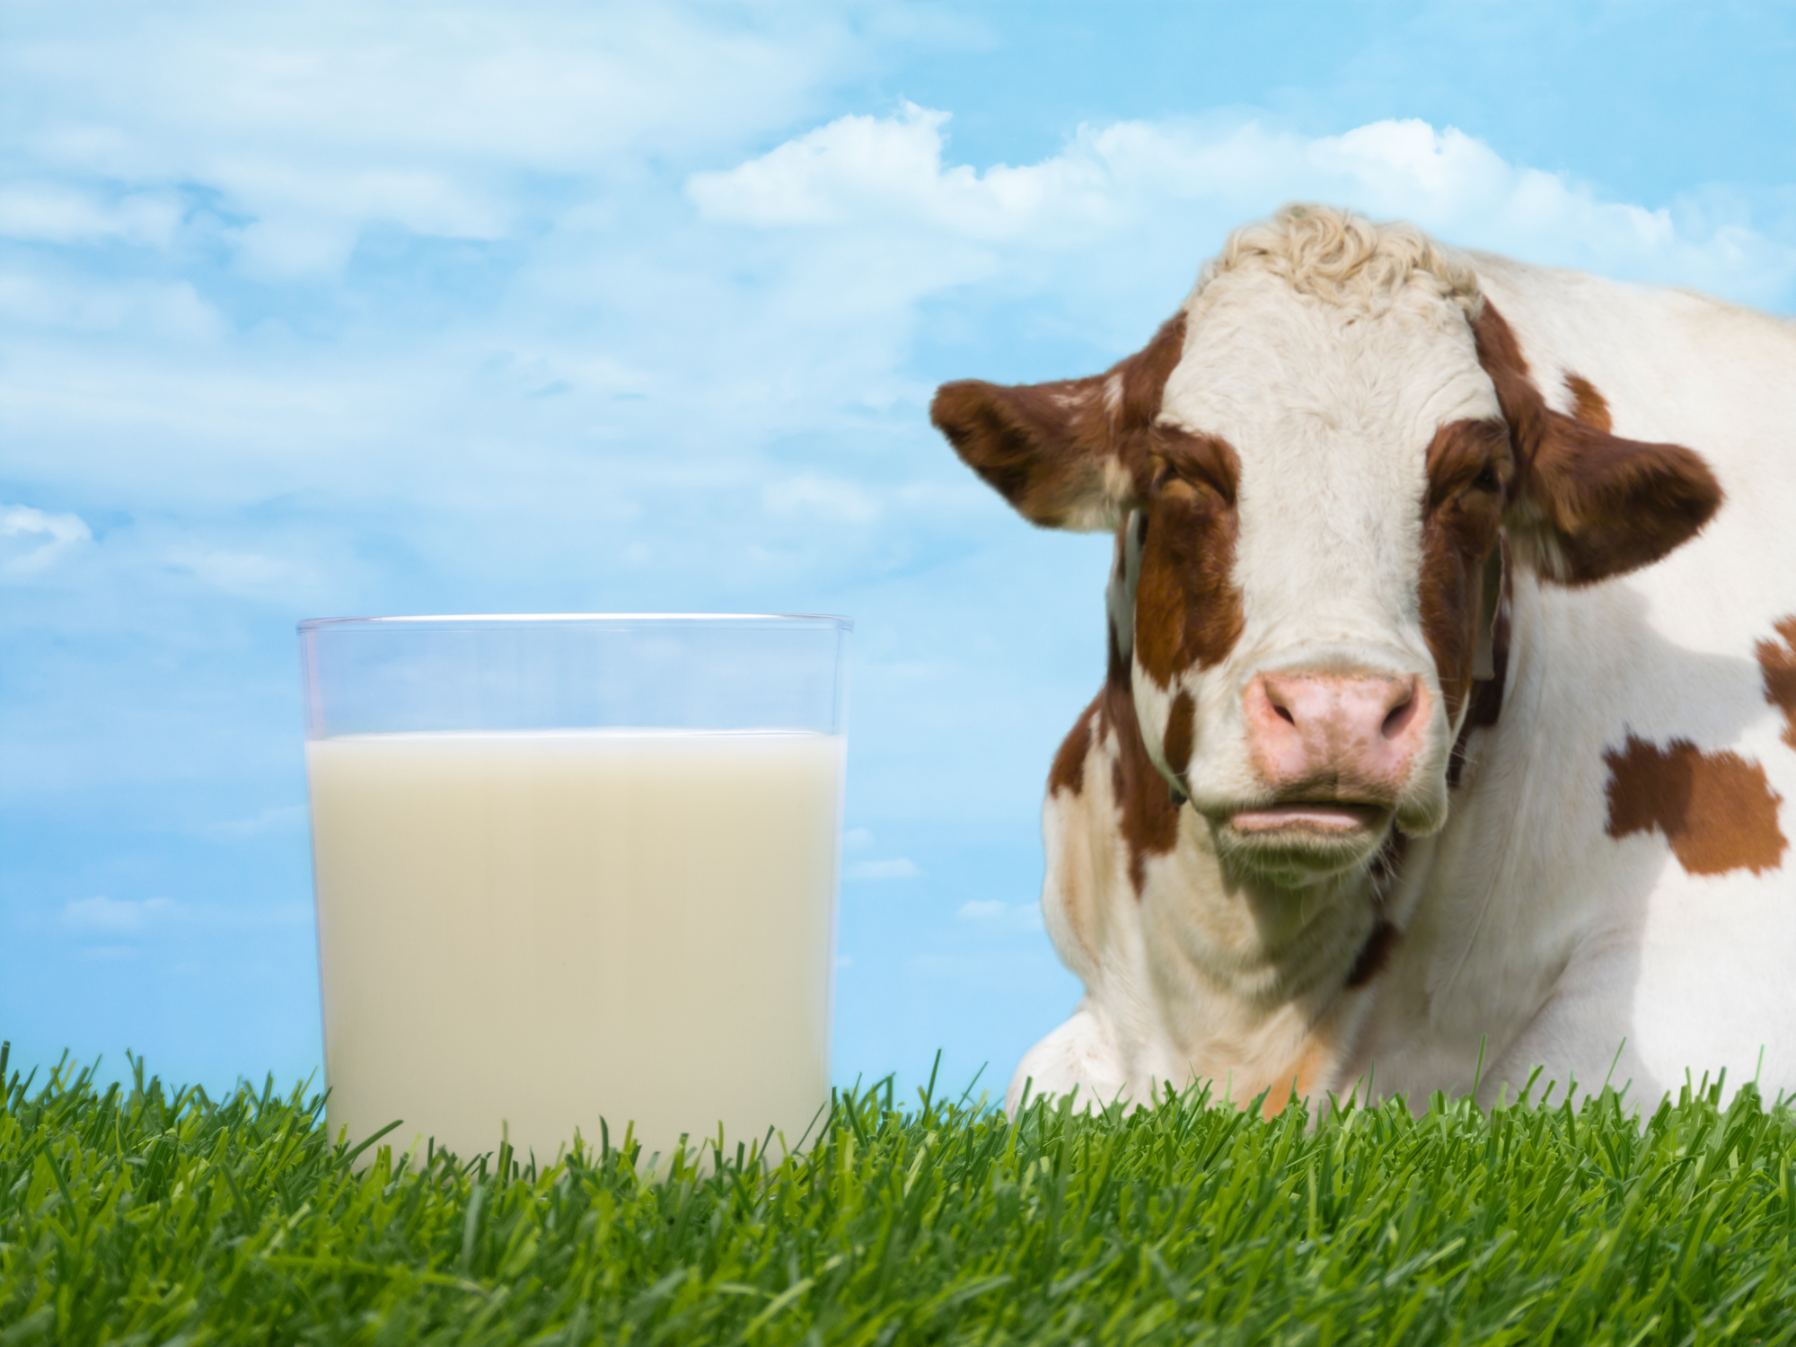
What do you want?
some milk
some mlik
a milk

Slide 14
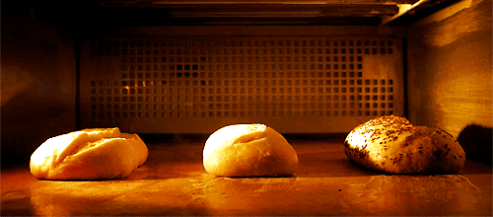
What do you want?
breads
some breed
some bread

Slide 15
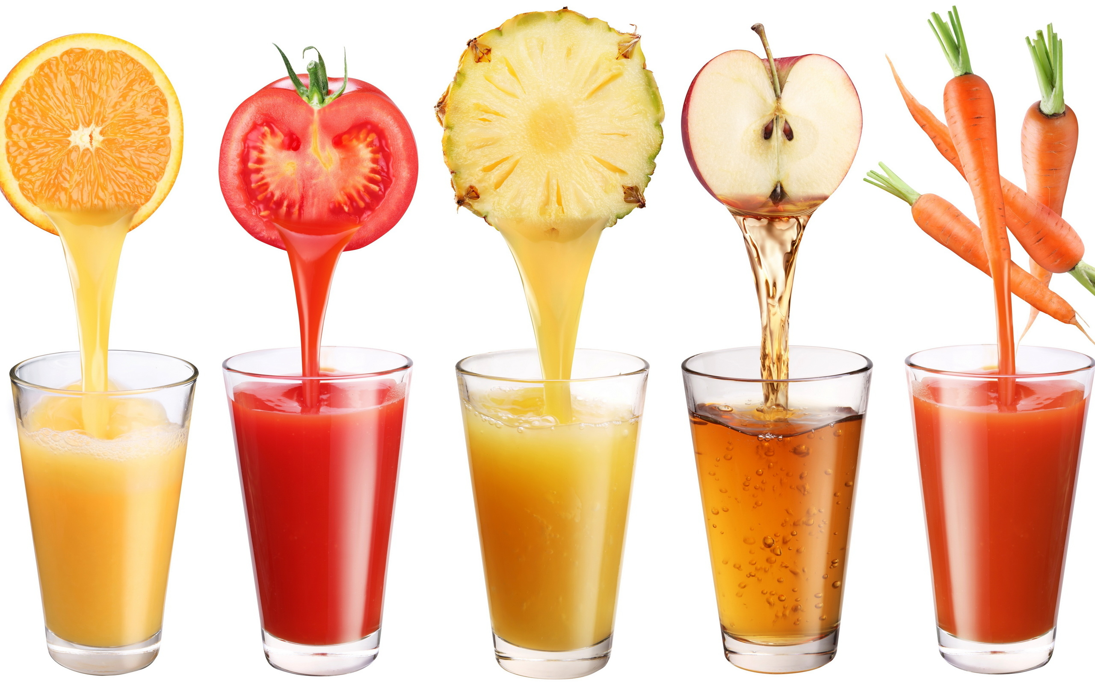
What do you want?
juices
some juice
5 juice

Slide 16
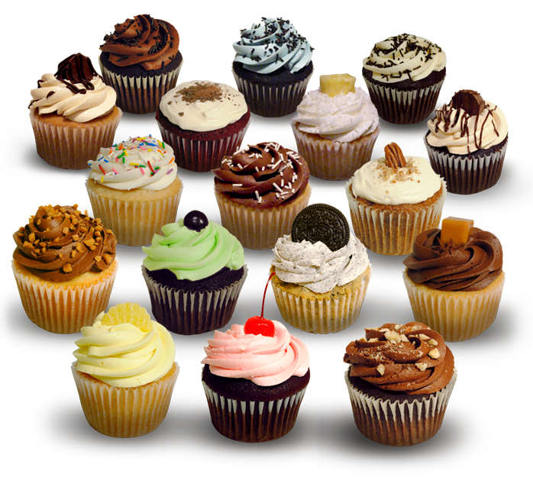
What do you want?
17 cupcake
a cupcake
some cupcakes

Slide 17
Let’s check the answers!!!!

Slide 18
What do you want?
(A) a hot dog (B) hot dogs (C) cupcakes

Slide 19
What do you want?
a tea
some tea
teas

Slide 20
What do you want?
a egg
some eggs
an egg

Slide 21
What do you want?
some milk
some mlik
a milk

Slide 22
What do you want?
breads
some breed
some bread

Slide 23
What do you want?
juices
some juice
5 juice

Slide 24
What do you want?
17 cupcake
a cupcake
some cupcakes

Slide 25
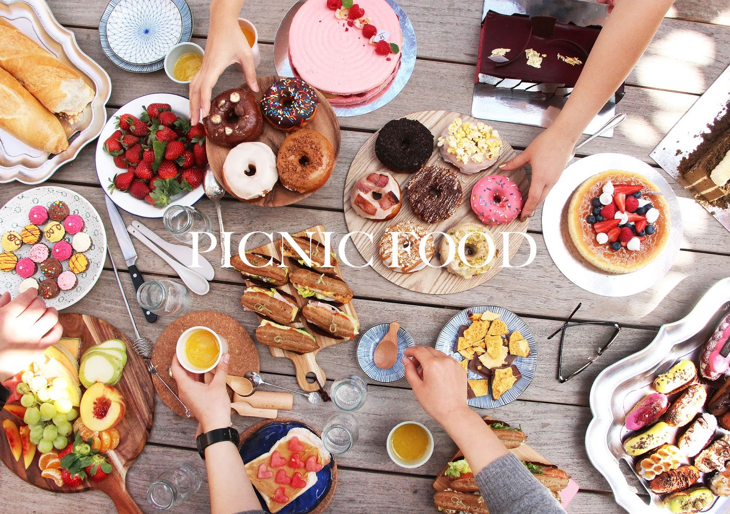
Story Time

Slide 26
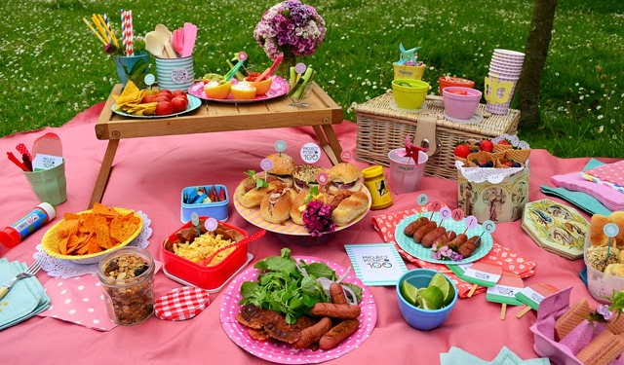
Danny’s mom: Come here, kids.
Danny: What do you want, Irene?
Irene: I want a hot dog. Thank you.

Slide 27
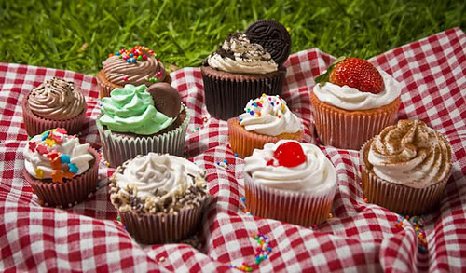
Danny: What do you want, Miss Lee?
Miss Lee: I want two cupcakes, please.
Danny: Here you are.
Miss Lee: Thank you, Danny.

Slide 28
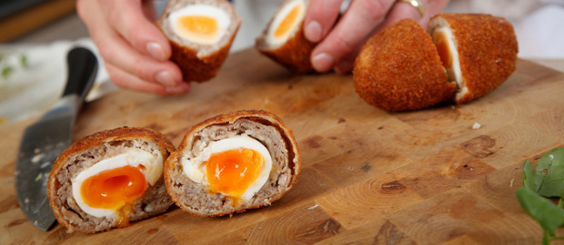
Danny: What do you want, Owen?
Owen: Hmm…Let me see.
What are these?
Danny: They’re eggs.

Slide 29
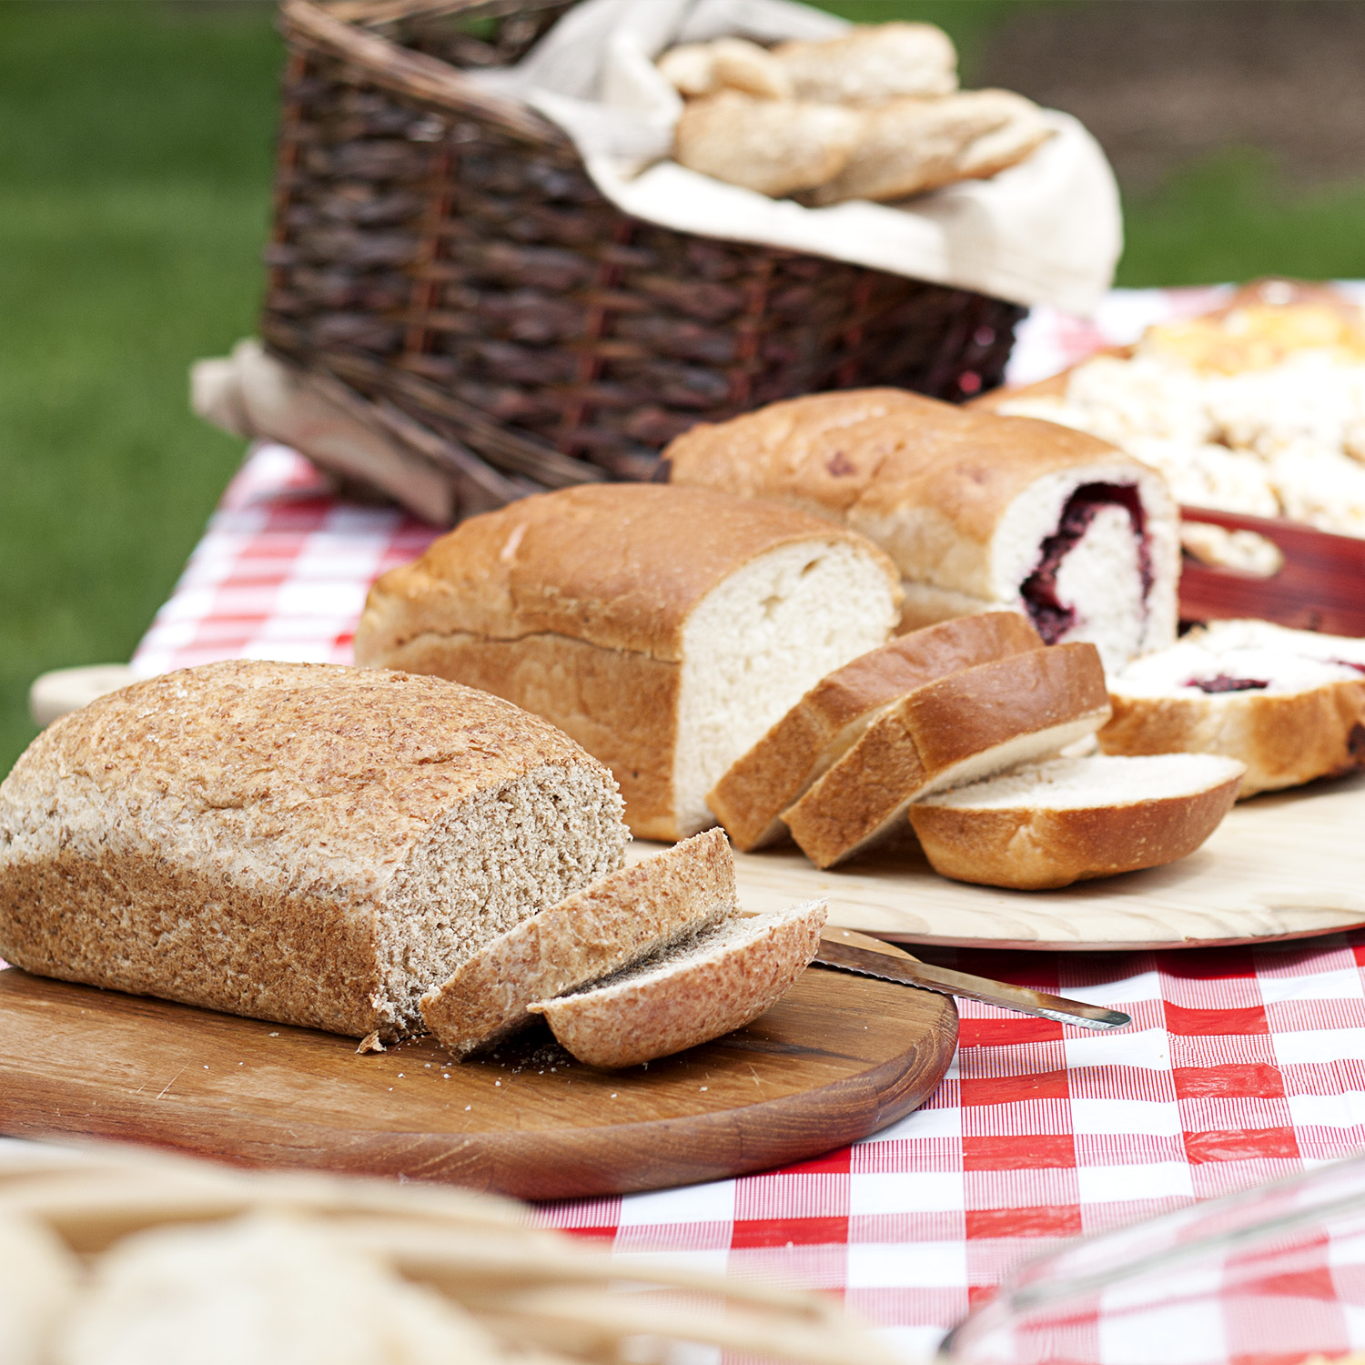
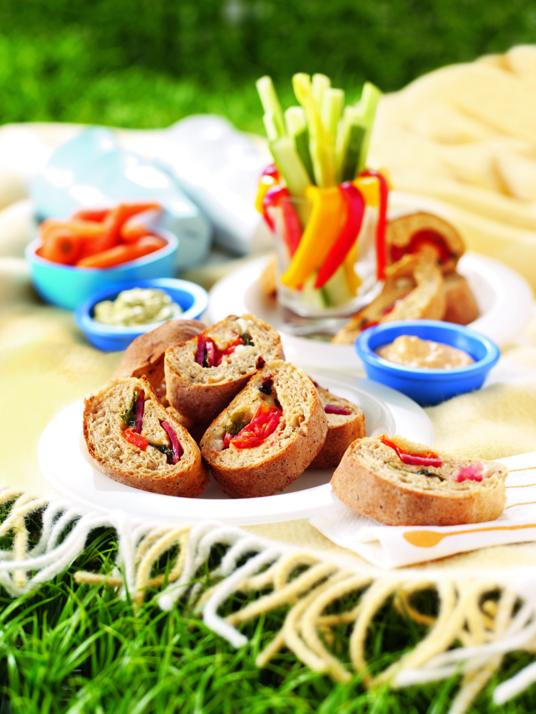
Danny: Hurry up!
Owen: I want some bread, please.
Thanks, Dino.
Dino: Hey! That’s my bread!

Slide 30
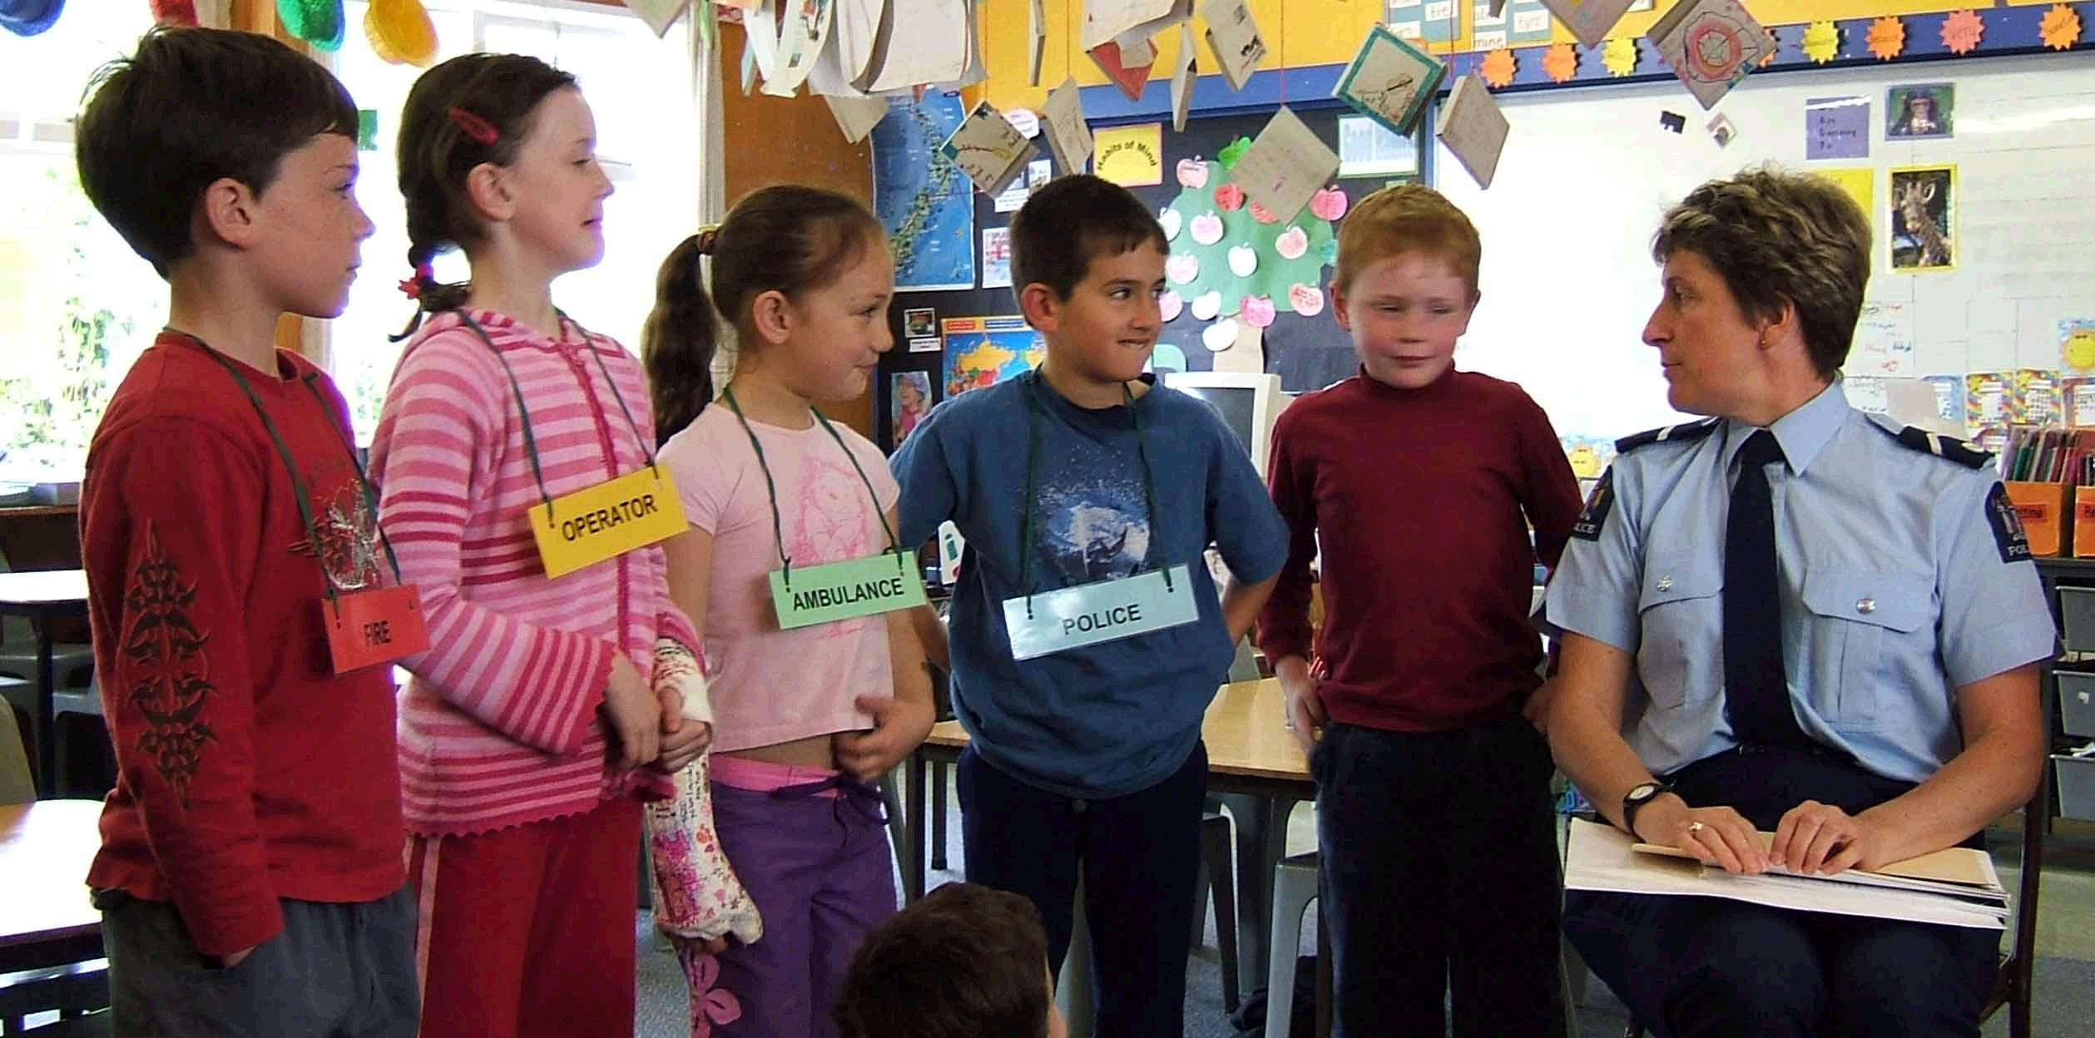
Let’s do a role play!

Slide 31
Danny’s mom: Come here, kids.
Danny: What do you want, Irene?
Irene: I want a hot dog. Thank you.

Slide 32
Danny: What do you want, Miss Lee?
Miss Lee: I want two cupcakes, please.
Danny: Here you are.
Miss Lee: Thank you, Danny.

Slide 33
Danny: What do you want, Owen?
Owen: Hmm…Let me see.
What are these?
Danny: They’re eggs.

Slide 34
Danny: Hurry up!
Owen: I want some bread, please.
Thanks, Dino.
Dino: Hey! That’s my bread!

Slide 35
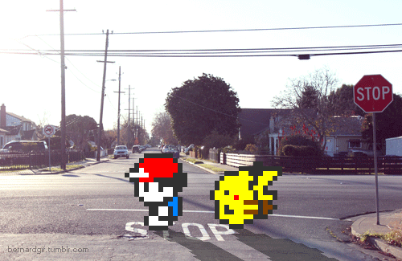
P60

Slide 36
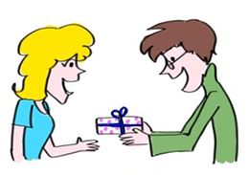
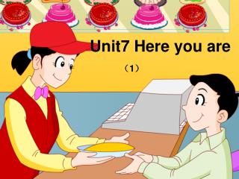
Here you are!

Slide 37
Hurry up!

Slide 38
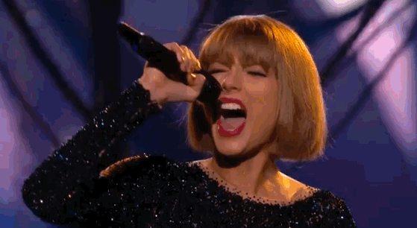
Let’s sing!!!!p63

Slide 39
P64~P65

Slide 40
-ug
-un

Slide 41
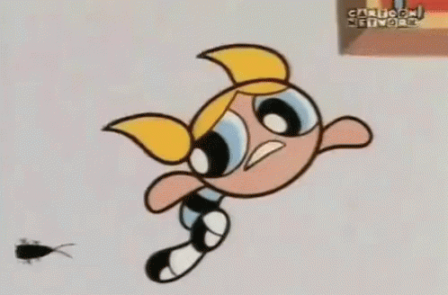
ug
b

Slide 42
m
ug

Slide 43
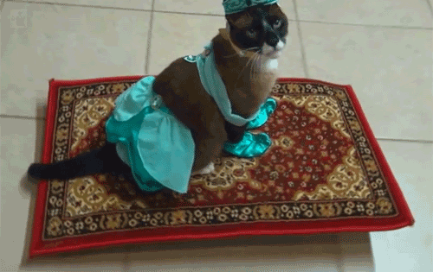
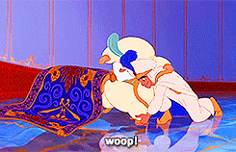
r
ug

Slide 44
This is a bug.

Slide 45
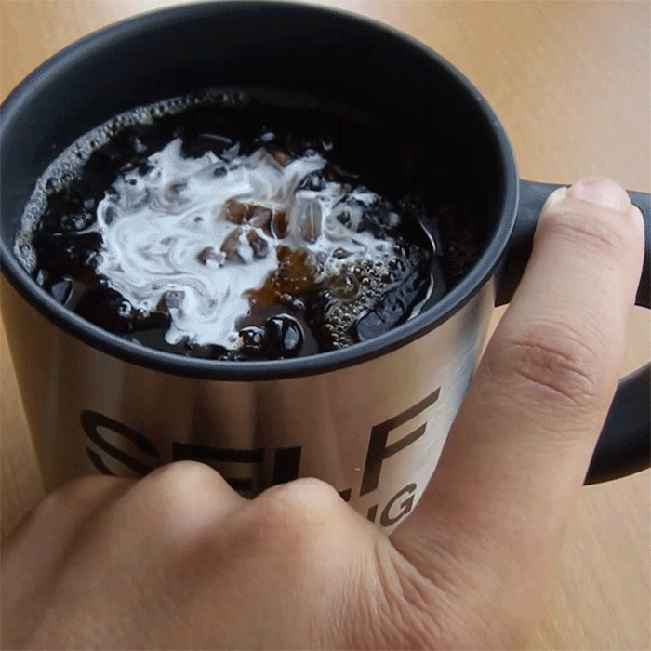
The bug is in the mug.

Slide 46
The mug is on the rug.

Slide 47
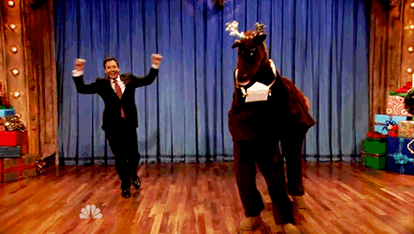
un
f

Slide 48
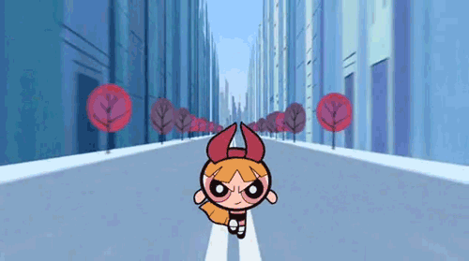
r
un

Slide 49
s
un

Slide 50
I like the sun.

Slide 51
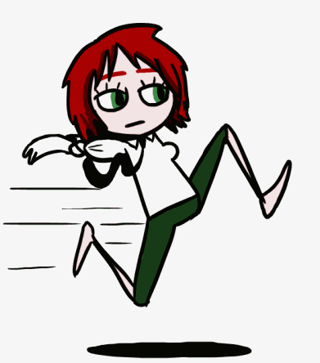
I like to run.

Slide 52
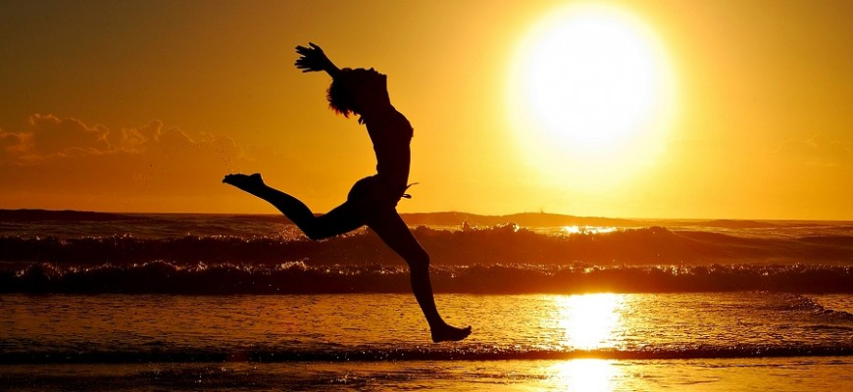
It’s fun to run in the sun.

Slide 53
This is a bug.
The bug is in the mug.
The mug is on the rug.

Slide 54
This is a bug.
The bug’s in the mug.
The mug’s on the rug.

Slide 55
I like the sun.
I like to run.
It’s fun to run in the sun.

Slide 56
-og
-ock

Slide 57
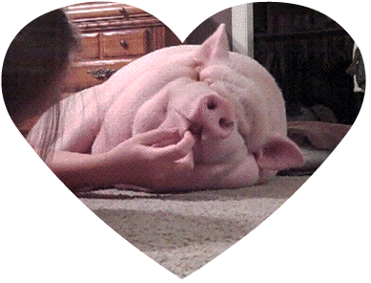
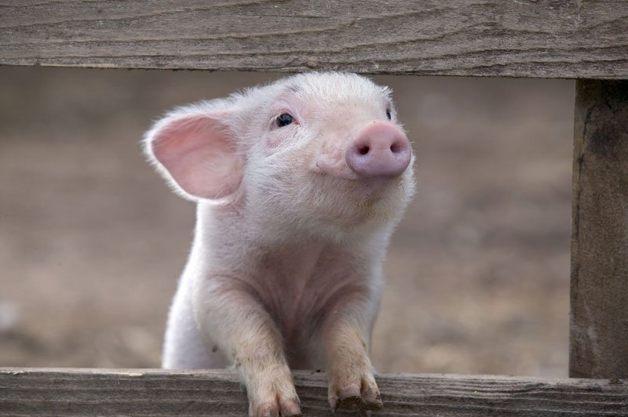
og
h

Slide 58
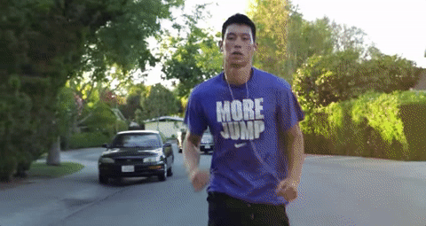
j
og

Slide 59
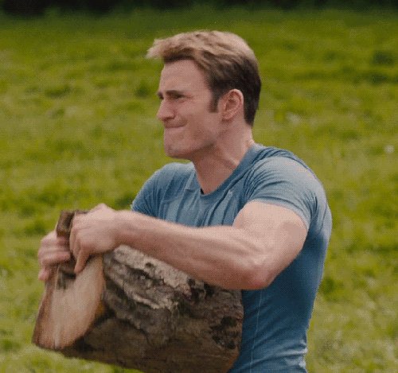
l
og

Slide 60
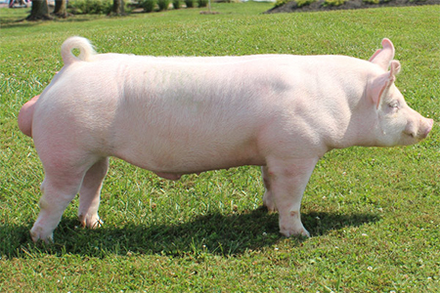
This is a hog.

Slide 61
The hog likes to jog.

Slide 62
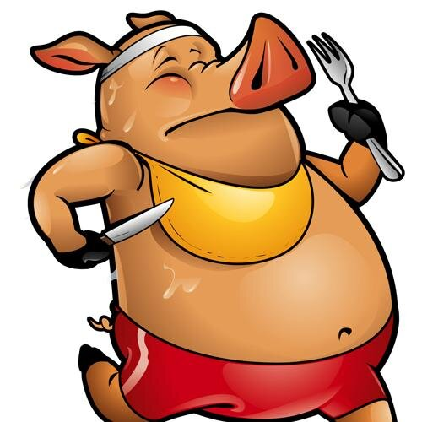
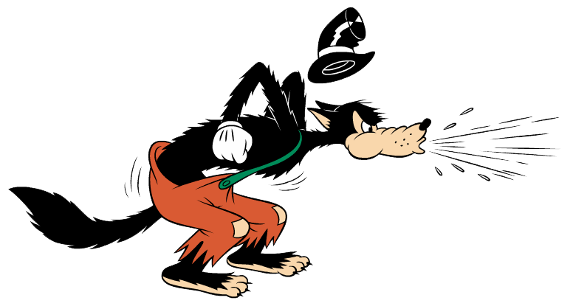
The hog likes to jog with a hog.

Slide 63
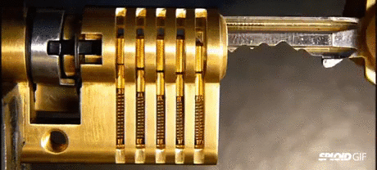
ock
l

Slide 64
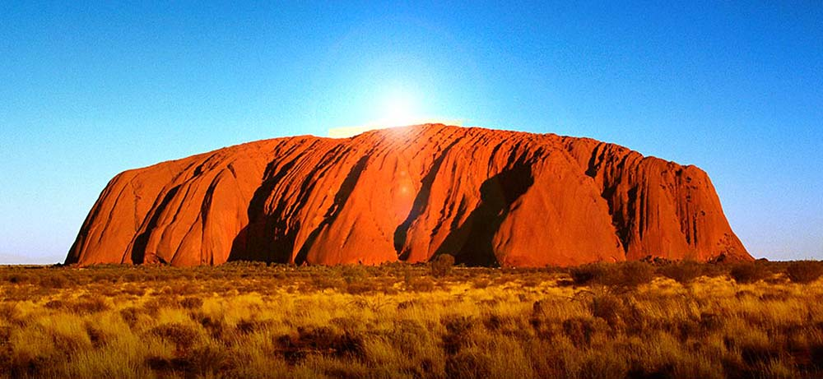
ock
r
Ayers Rock in Australia

Slide 65
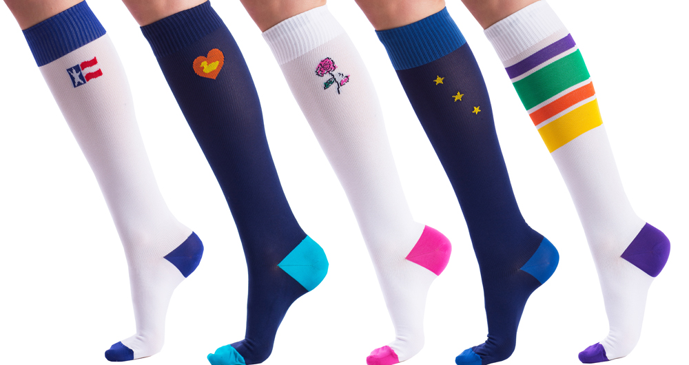
ock
s

Slide 66
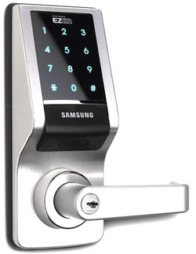
This is a lock.
These are locks.

Slide 67
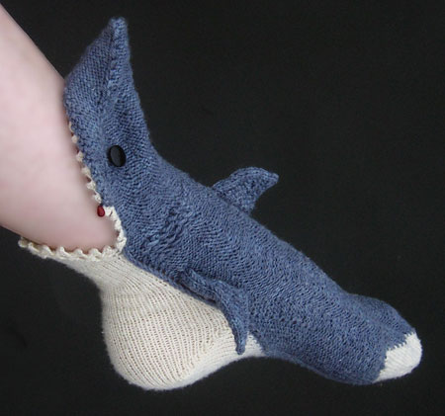
This is a sock.

Slide 68
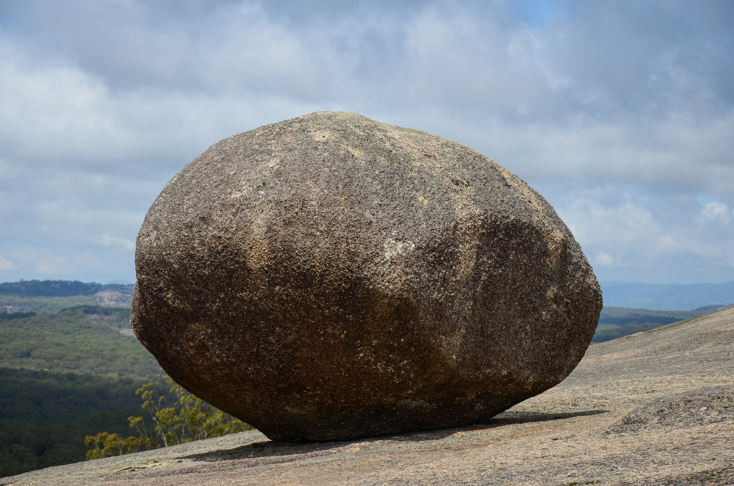
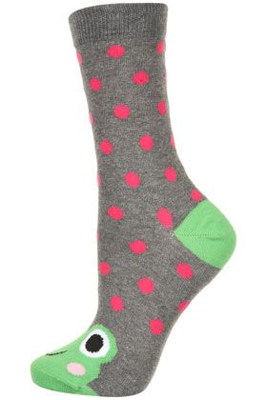
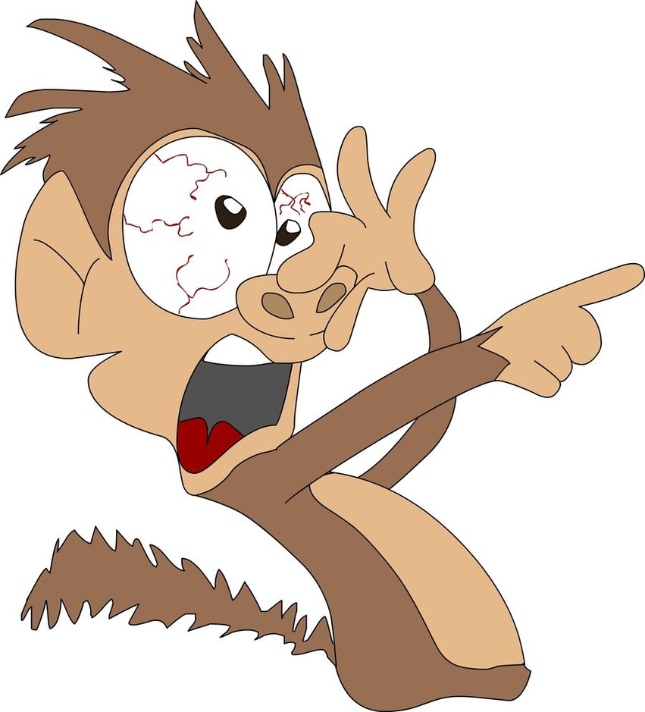
The lock and the sock are on the rock.

Slide 69
This is a hog.
The hog likes to jog.
The hog likes to jog with a log.

Slide 70
This is a lock.
This is a sock.
The lock and the sock are on the rock.

Slide 71
-ip
-it

Slide 72
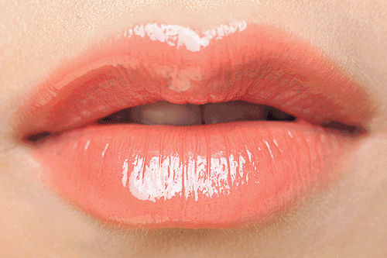
ip
l

Slide 73
s
ip

Slide 74
z
ip

Slide 75
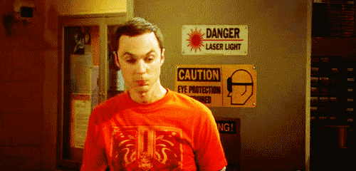
Zip your lip.

Slide 76
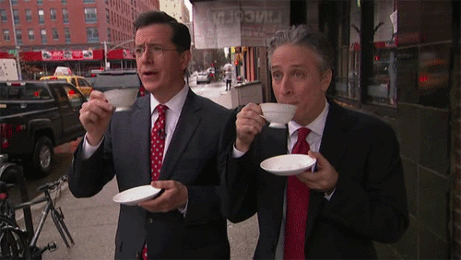
Sip your tea.

Slide 77
Zip your lip and sip your tea.

Slide 78
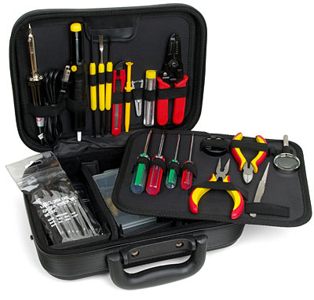
k
it

Slide 79
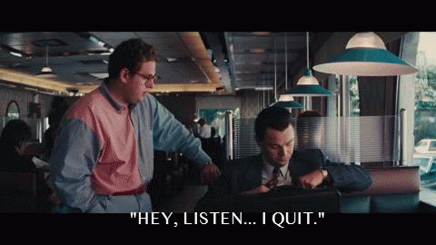
qu
it

Slide 80
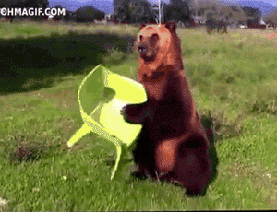
s
it

Slide 81
Don’t quit.

Slide 82
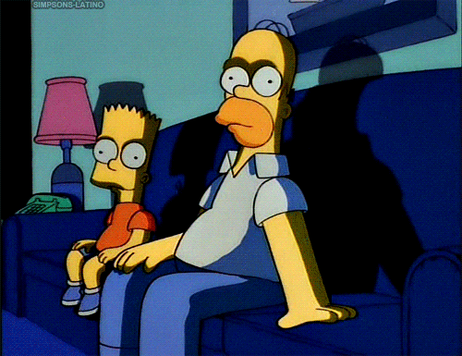
Sit for a bit.

Slide 83
You can sit by the kit.

Slide 84
-en
-ell

Slide 85
h
en

Slide 86
p
en

Slide 87
t
en

Slide 88
This is a hen.

Slide 89
The hen has a pen.

Slide 90
Oh! The hen has ten pens.

Slide 91
b
ell

Slide 92
s
ell

Slide 93
y
ell

Slide 94
He has a bell.

Slide 95
He can yell.

Slide 96
He can yell and sell the bell.

Slide 97
-am
-an

Slide 98
h
am

Slide 99
j
am

Slide 100
S
am
Sam Claflin

Slide 101
Sam likes ham.

Slide 102
Sam likes jam.

Slide 103
Sam likes ham
and jam.

Slide 104
m
an

Slide 105
f
an

Slide 106
v
an

Slide 107
This is a man.

Slide 108
He has a fan.

Slide 109
The man has a fan in his van.

Slide 111
英語期末考範圍:
Unit3~Unit4 (全)要背單字、Phonic+生活用語(Starter Unit ~Unit4)、口試(Unit4的Story Time，分組上台抽角色發表)

